Slide 1
Specimen
Jennifer Fostel & Jie Zheng

Slide 2
Specimen Role, Material Sample Role and Study Subject Role
Specimen role
  a role borne by a material entity that is gained during a specimen creation process and that can be realized by use of the specimen in an investigation. (A specimen creation objective is to obtain a material entity for potential use as an input during an investigation.)
Material sample role
  A material sample role is a specimen role borne by a material entity that is the output of a material sampling process (A specimen gathering process with the objective to obtain a specimen that is representative of the input material entity).
Study subject role
  study subject role inheres in an entity and realized through the execution of a study design in which the entity participates by being that which the results are about.

Slide 3
Experiment 1
  People took rats
  treated rats with drug
  Took rat’s liver, heart, blood, etc. tissues
  Stored tissues
  Extract RNA from liver and blood
  Did microarray assay
  Conclusion: Rats treated with drug A,B,C have same response.

Slide 4
Experiment 2
  People took rats liver cells
  treated rat liver cells with drug
  Collect cells
  Stored cells
  Extract RNA
  Did microarray assay
  Conclusion: Rat liver cells treated with drug A,B,C have same response.

Slide 5
Experiment 3
  Use stored rat’s heart from Experiment 1
  Extract RNA from heart
  Did microarray assay
  Conclusion: Rats treated with drug A,B,C have same response.

Slide 6
Experiment 4
  People took rats
  treated rats with drug
  Took rat’s heart
  Stored rat’s heart
  Extract RNA from heart
  Did microarray assay
  Conclusion: Rats treated with drug A,D,E have same response.

Slide 7
Experiment 5
  Took rat’s heart from Experiment 1 and 4
  Stored rat’s heart
  Extract RNA from heart
  Did microarray assay
  Conclusion 1: Rats treated with drug A have same response.
  Conclusion 2: Storage of heart has no impact on drug response.

Slide 8
Experiment 6
  Get microarray data from experiment 3 and 4
  Data analysis
  Conclusion: Rats treated with drug B,C have different response from D,E.

Slide 9
Experiment 7
  People took pond water, lake water, or river water in different locations (USA, Africa, etc.)
  examined microorganism, chemical components in the water
  Conclusion: Pond water in Africa was polluted.

Slide 10
Experiment 8
  People took pond water, lake water, or river water in different locations (USA, Africa, etc.)
  Extract DNA of parasite in the water
  Sequencing assay
  Conclusion: sequence of isolate in different sources are varied

Slide 11
Questions
What is study subject in Experiment 1-8?
What is specimen in Experiment 1-8?
What is material sample in Experiment 1-8?

Slide 12
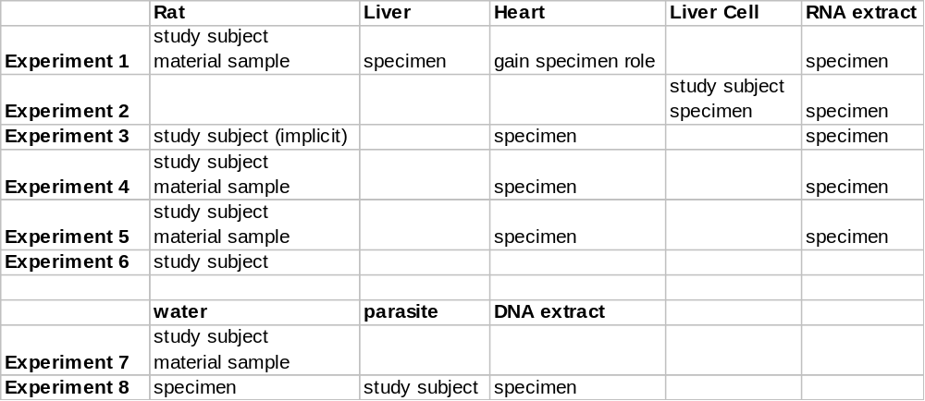
Roles of Material Entity

Slide 13
Tissue specimen and
Sample from organism
Tissue specimen
  A specimen that derives from an anatomical part or substance arising from an organism. Examples of tissue specimen include tissue, organ, physiological system, blood, or body location (arm).
  ('has role' some 'specimen role')
  and ('derives from' some 'gross anatomical part')
Sample from organism
  a material obtained from an organism in order to be a representative of the whole.
  ('has role' some 'material sample role')
  and (is_specified_output_of some 'collecting specimen from organism')
  'derives from' some 'gross anatomical part‘
Question: Do we need both?

Slide 14
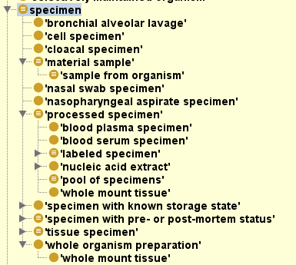
Specimen Hierarchy
Based on material:
cell specimen, tissue specimen
Based on storage method:
fresh specimen, frozen specimen
Based on collection method:
nasal swab specimen, sample from organism
Based some process after collection:
labeled specimen, nucleic acid extract
How about based on study subject?
pathogenic organism water specimen, bacteria nasal swab specimen

